Slide 1
Darwin Core
Terms and Record Types
Notes:
-

Slide 2

Darwin Core
Body of standards, including a glossary of terms to facilitate sharing of biodiversity information
Managed by Biodiversity Information Standards (TDWG)
Versions
Darwin Core 1.0 (1998)
Darwin Core 1.2 (2001) – OBIS Extension of DwC 1.2
Darwin Core 1.4 (2005)
ratified Darwin Core (2009) – OBIS transitioned to ratified DwC in 2013
Simple Darwin Core
Terms definitions: http://rs.tdwg.org/dwc/terms
For a list of Darwin Core terms in use by OBIS (and GBIF) see http://rs.gbif.org
Notes:
Darwin Core is a body of standards for biodiversity informatics. It provides stable terms and vocabularies for sharing biodiversity data. Darwin Core is maintained by TDWG (Biodiversity Information Standards, formerly The International Working Group on Taxonomic Databases).
We are going to go through the Darwin Core terms, both those required by obis, and the optional ones. We will look at how those terms are defined, their guidelines for use, and tools available to help populate certain of the terms accurately.
We will follow this with a demo using one of your datasets, and then there will be time for the group to practice that exercise.
No specimen preserved - HumanObservation vs MachineObservation

Slide 3
DwC Required Terms
occurrenceID - institutionCode + collectionCode + catalogNumber
eventDate - uses the ISO 8601 standard, yyyy-mm-ddThh:mm:ss
decimalLongitude, decimalLatitude - spatial reference system EPSG:4326
scientificName - originally recorded, highest precision possible
scientificNameID - from WoRMS
occurrenceStatus - presence/absence of taxon at location
basisOfRecord - specimen preserved? If so where. Human or Machine Observation
Notes:
OBIS currently has eight required DwC terms: occurrenceID, eventDate, decimalLongitude, decimalLatitude, scientificName, scientificNameID, occurrenceStatus, basisOfRecord.
occurrenceID could be constructed by combining the institutionCode, the collectionCode and the catalogNumber
basisOfRecord - specimen preserved, need information about where it is stored, collection etc
No specimen preserved - HumanObservation vs MachineObservation

Slide 4
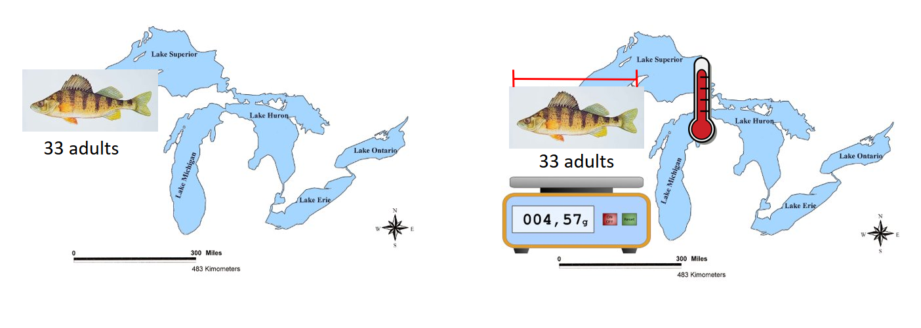
Occurrence vs Event - Trawl Survey
Occurrence Only
OBIS ENV data
Notes:
Lets look at an example of a trawl survey on the great lakes.

Slide 5
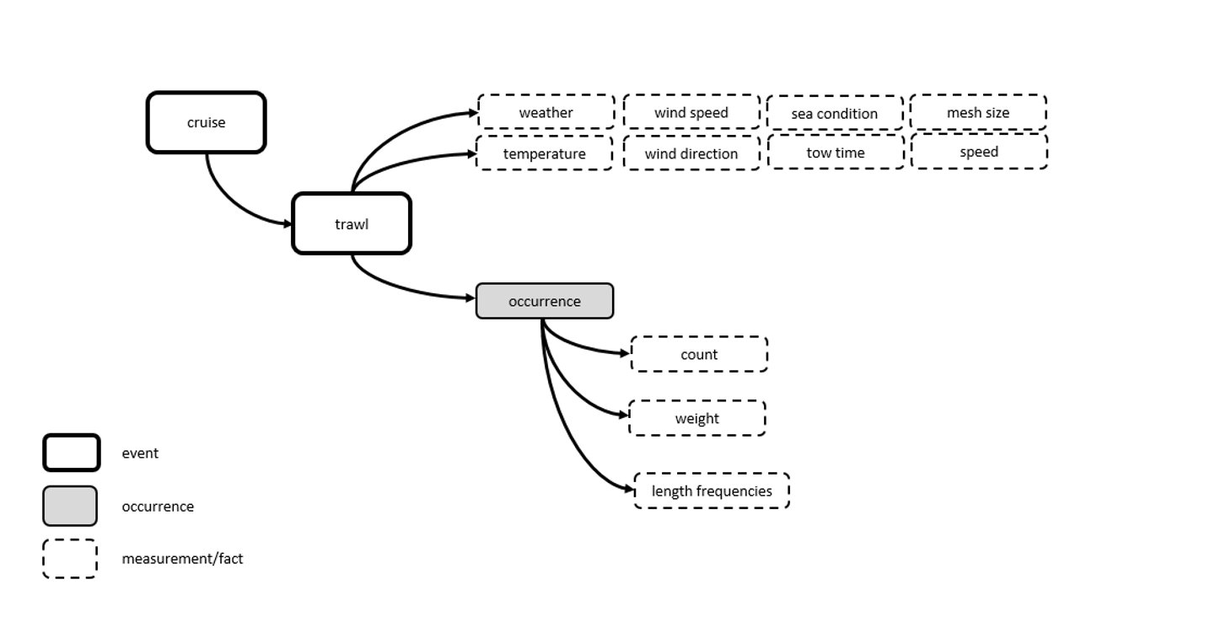
Occurrence vs Event

Slide 6
DwC Taxonomy and Identification
Terms
scientificName
scientificNameID
scientificNameAuthorship
kingdom, phylum, ... : useful to discriminate homonyms
taxonRank
identifiedBy : e.g. Person or machine
dateIdentified: use ISO 8601 (see next slides)
identificationReferences: e.g. field guides…
identificationRemarks : e.g. Identification methods
identificationQualifier

Slide 7
DwC Taxonomy and Identification
scientificName
lowest level taxonomic rank that can be determined
no identification qualifiers (cf., aff.), see identificationQualifier
OBIS recommended practice: no authorship
scientificNameID
WoRMS LSID, no matter if the taxonomic status is accepted or not. Double check if authority and kingdom are correct
urn:lsid:marinespecies.org:taxname:141433
Examples
scientificName | scientificNameID | identificationQualifier
Peltodoris atromaculata | urn:lsid:marinespecies.org:taxname:509315
Peltodoris | urn:lsid:marinespecies.org:taxname:225423 | cf. atromaculata

Slide 8
Occurrence
Terms
basisOfRecord
occurrenceStatus
associatedMedia
associatedReferences
associatedSequences
associatedTaxa
recordedBy
occurrenceRemarks
dataGeneralizations

Slide 9
Occurrence
Terms
basisOfRecord
PreservedSpecimen: when specimen is deposited in a collection (please add institutionCode, collectionCode and CatalogNumber)
FossilSpecimen: important to distinguish collection date from geological time zone
LivingSpecimen: an intentionally kept/cultivated living specimen e.g. in an aquarium or culture collection
HumanObservation: e.g. bird sighting, benthic sample but specimens were discarded after counting
MachineObservation: sensors, e.g. DNA sequencers, image recognition
occurrenceStatus
Present or Absent (individualCount = 0)

Slide 10
Occurrence
Terms
global unique identifiers or URIs for:
associatedMedia: Online images, videos
associatedReferences: DOIs
associatedSequences: e.g. GenBank ID
associatedTaxa: species associations, e.g. the species occurrence was associated to the presence of kelp such as Laminaria digitata.
dataGeneralizations: refers to actions taken to make the shared data less specific or complete than in its original form. Suggests that alternative data of higher quality may be available on request. This can be the case for occurrences of vulnerable or endangered species and there positions are converted to the center of grid cells.

Slide 11
Location
Terms
decimalLongitude, decimalLatitude
coordinateUncertaintyInMeters
geodeticDatum
OBIS recommended practice: EPSG:4326
footprintWKT (see further slides)
continent, waterBody, islandGroup, island, country, municipality, ...
locality
most specific location description
locationID
for example MRGID from http://www.marineregions.org
minimumDepthInMeters, maximumDepthInMeters

Slide 12
Location
Before conversion to decimals | In decimal format
18°30’25’’N – 5°15’E | 18.51; 5.25
54,23N – 16,5S | 54.23 ; -16.5
Possible issues with coordinates
S and W coordinates missing minus sign
Latitudes and Longitudes are switched
Not in decimal degrees
-150.244.444.444.444
34.5673°
14°35’26’’N
Values outside EPSG:4326 bounds (Lon: -180 to 180 and Lat: -90 to 90)
-551.675
Number format (dot as comma separator)
-54,3212

Slide 13
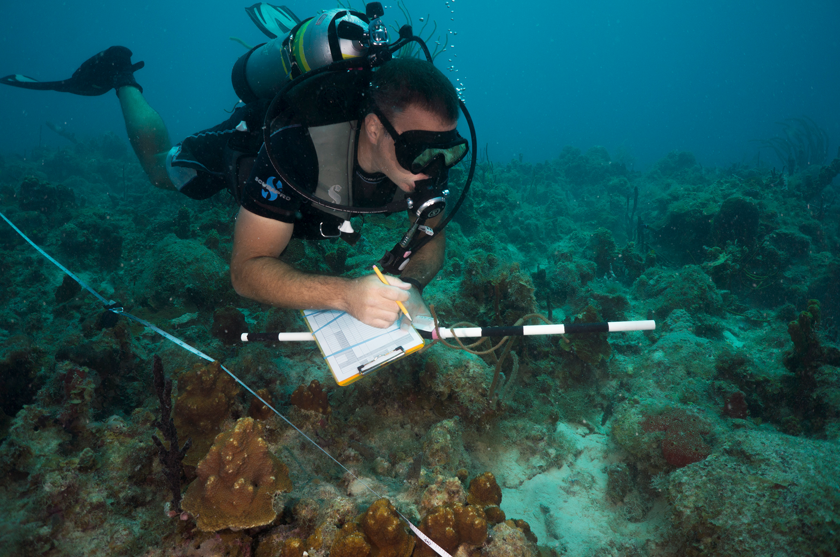
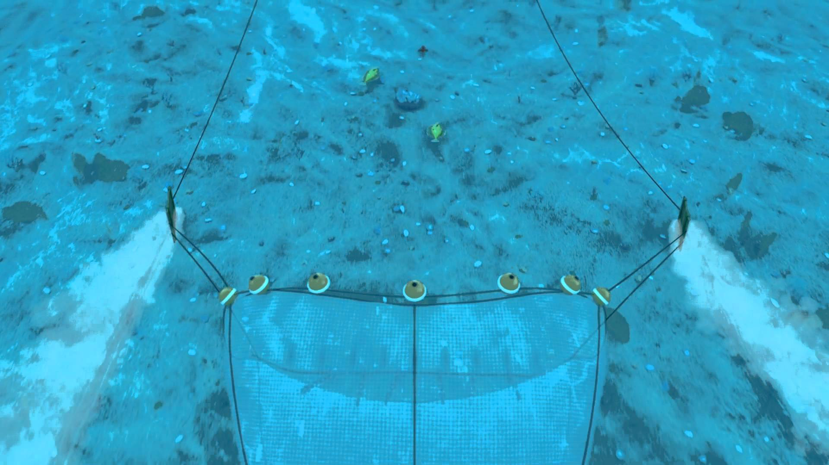
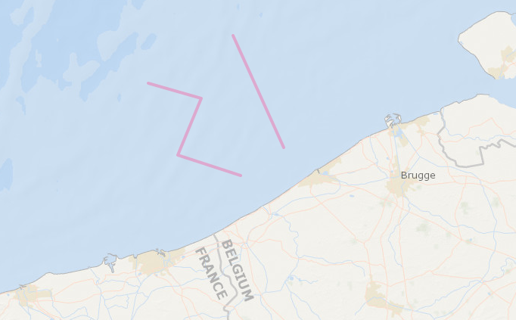
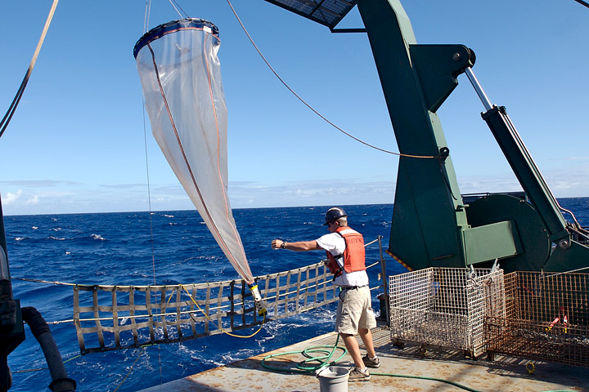
Location
footprintWKT: transects
LINESTRING (2.80151 51.28597, 2.61749 51.53950)
LINESTRING (2.64496 51.22237, 2.41699 51.26879, 2.50214 51.39749, 2.30988 51.43175)

Slide 14
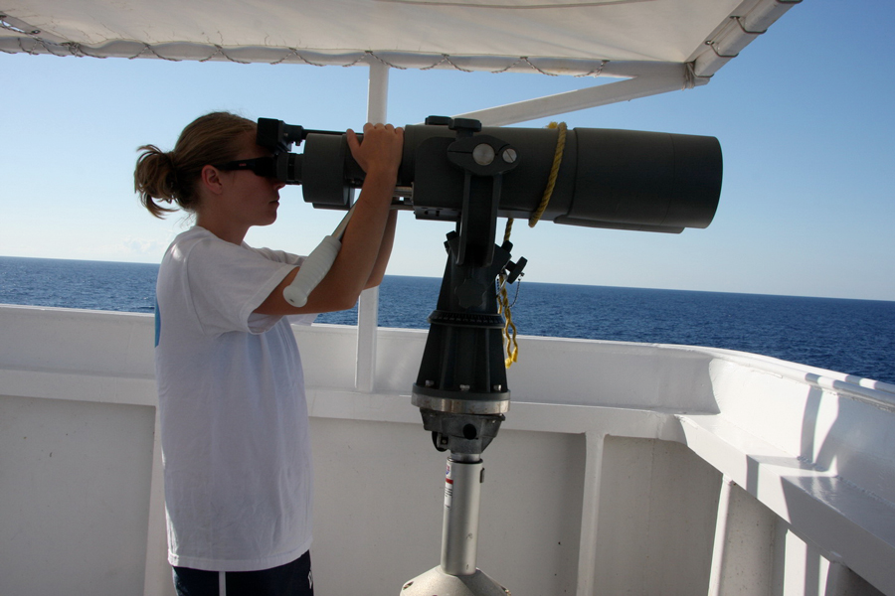
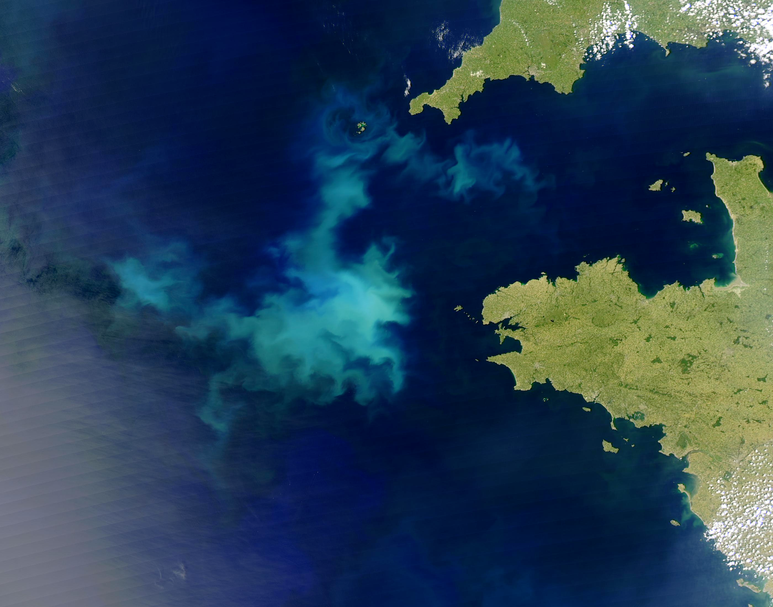
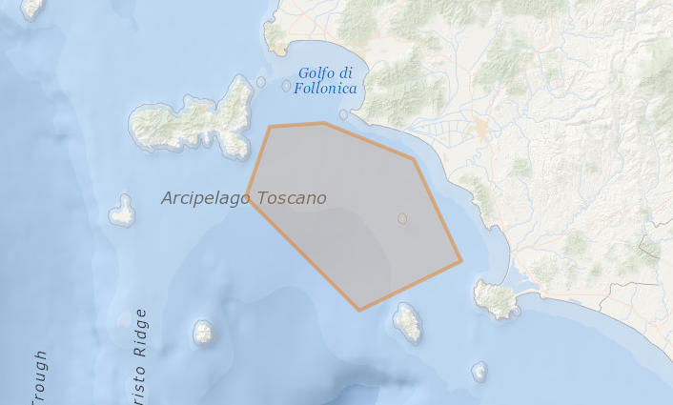
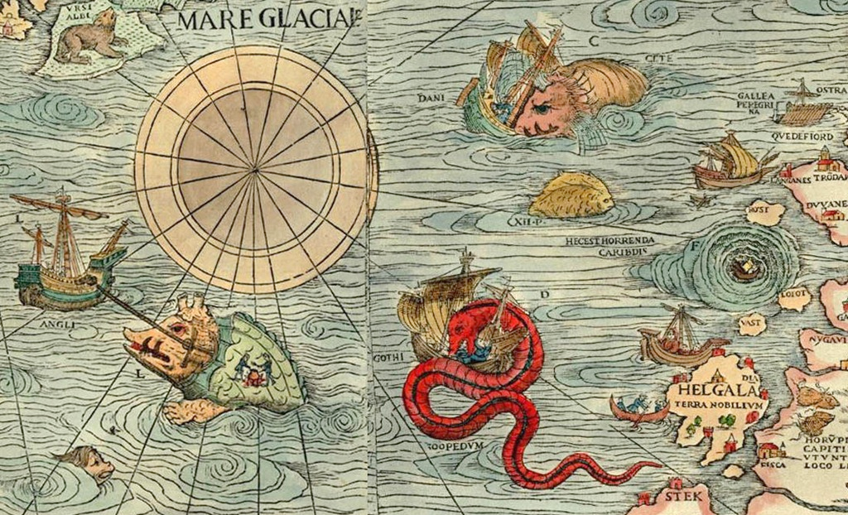
Location
footprintWKT: polygons
POLYGON ((10.65674 42.77928, 10.50018 42.77121, 10.43152 42.62183, 10.75836 42.38087, 11.05225 42.48628, 10.91492 42.70262, 10.65674 42.77928))

Slide 15
Location
Examples
locality | locationID | decimal Longitude | decimal Latitude | coordinate Uncertainty InMeters | minimum Depth InMeters | maximum Depth InMeters | footprint WKT
Ha Long Bay | MRGID:8897 | 107.1 | 20.9 | 26000
station_115 |  | 2.6999 | 51.2219 | 50 | 30 | 30
 |  | 2.5996 | 51.2765 | 8134 | 5 | 10 | LINESTRING (2.53510 51.21549, 2.66418 51.33748)

Slide 16
Time
Terms
eventDate
verbatimEventDate (not recommended)
ISO 8601
1973-02-28T15:25:00
1973-02-28
1973-02
1973
1973-02-28T15:25:00Z (UTC)
1993-01-26T04:39+12/1993-01-26T05:48+12
2015-023
2014-W26

Slide 17
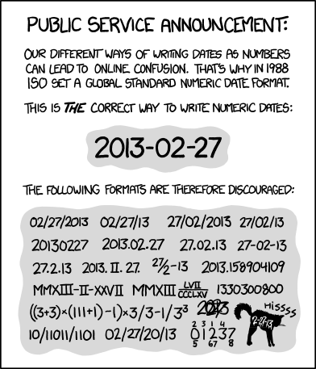
Time
Not ok:
2015/07/11
1915-6-9 0:00:00
1995-7-0
09-Dec-2009
10-01-2013
1:25
00:18:00+0:00
Jan

Slide 18
Identifiers
Terms
institutionCode
institution who has custody over the collection or dataset
collectionCode
identifier for the collection or dataset (same for all records)
catalogNumber
unique key within the dataset
occurrenceID
globally unique
urn:catalog:[institutionCode]:[collectionCode]:[catalogNumber]
recordNumber
organismID

Slide 19
Identifiers
Examples
institutionCode | collectionCode | catalogNumber | occurrenceID
UGent | Macrobel | 28125 | urn:catalog:UGent:Macrobel:28125
ICES | DATRAS-EVHOE | 865761 | urn:catalog:ICES:DATRAS-EVHOE:865761

Slide 20
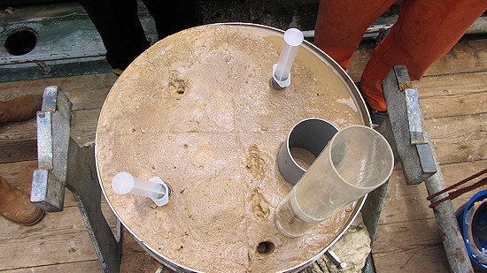
Identifiers
Terms
eventID, parentEventID → dataset structure

Slide 21
Identifiers
Example
eventID | parentEventID | type | eventDate | decimalLongitude | decimalLatitude
cruise_1 |  | cruise
cruise_1:station_1 | cruise_1 | station |  | -12.0190 | 33.9069
cruise_1:station_1:grab_1 | cruise_1:station_1 | grab | 2016-01-02T16:02
cruise_1:station_1:grab_2 | cruise_1:station_1 | grab | 2016-01-02T16:24
cruise_1:station_1:grab_1:subsample_1 | cruise_1:station_1:grab_1 | subsample

Slide 22
Quantity
Terms
individualCount
organismQuantity
organismQuantityType
sampleSizeValue
sampleSizeUnit
OBIS recommended practice: add sampling parameters and quantities in the ExtendedMeasurementOrFact Extension

Slide 23
Measurement Or Fact
ID: the identifier used by DwC-A standard to link the eMoF to the Core file.
occurrenceID (new): identifier to link the eMoF with the occurrence extension.
measurementType: The nature of the measurement, fact, characteristic, or assertion.
measurementTypeID (new): An identifier for the measurementType (global unique identifier, URI)
measurementValue: The value of the measurement, fact, characteristic, or assertion.
measurementValueID (new): An identifier for facts stored in the column measurementValue (global unique identifier, URI)
measurementAccuracy: The description of the potential error associated with the measurementValue.
measurementUnit: The value of the measurement, fact, characteristic, or assertion.
measurementUnitID (new): An identifier for the measurementUnit (global unique identifier, URI)
measurementDeterminedDate: The date on which the MeasurementOrFact was made.
measurementDeterminedBy: A list (concatenated and separated) of names of people, groups, or organizations who determined the value of the MeasurementOrFact.
measurementMethod: A description of or reference to (publication, URI) the method or protocol used to determine the measurement, fact, characteristic, or assertion.
measurementRemarks: Comments or notes accompanying the MeasurementOrFact.

Slide 24
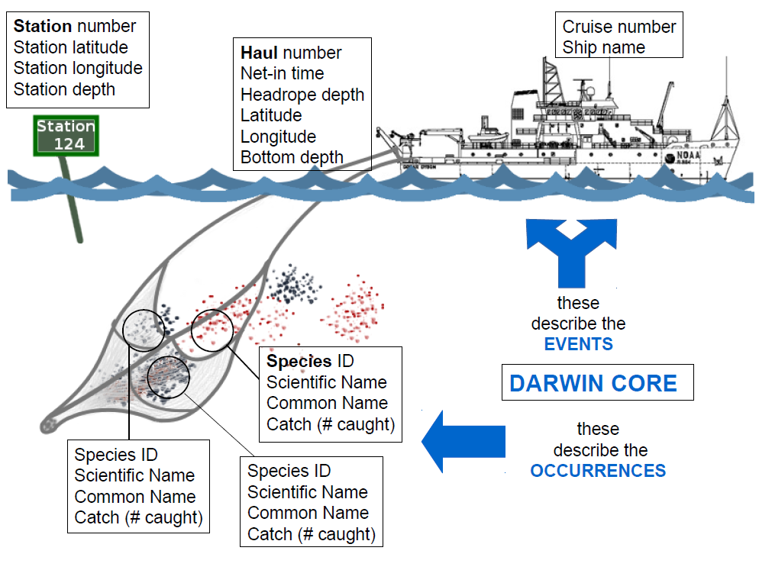
Notes:
A hypothetical example, this image shows the complexity that is possible when linking events, occurences and measurements or facts.

Slide 25
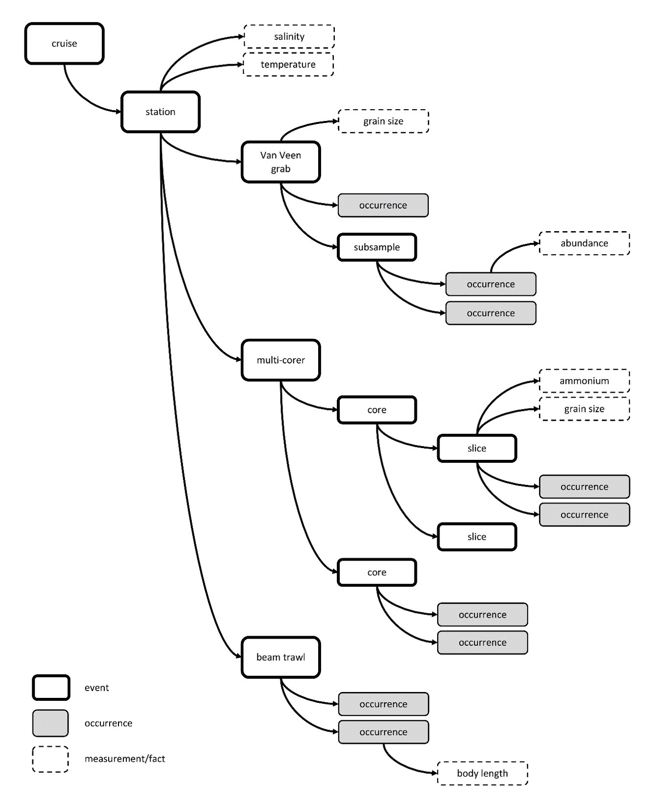
Biological Sampling
Beyond species occurence
A hypothetical example based on a complicated sequence of sampling events at a given sampling location. In the example the bold rectangles are sampling events, the dashed rectangles measurements or facts, the grey rectangles are occurrences.
The arrows between the rectangles illustrate the (hierarchical) relations between the different sampling events and between events and their associated occurrences and measurements. The example shows data sampled using a Van Veen grab, a beam trawl, and a multi-corer. The macrobenthos analysis was based on the complete Van Veen grab sample, while the meiofauna analysis was based on subsamples. The multicore sample was divided into different depth slices. Likewise, an abiotic measurement can refer to the entire sample or to a subsample.
Source: De Pooter et al (2017). https://doi.org/10.3897/BDJ.5.e10989​
Notes:
A hypothetical example, this image shows the complexity that is possible when linking events, occurences and measurements or facts.

Slide 26
DwC Resources
Terms definitions: http://rs.tdwg.org/dwc/terms
Marine region gazetteer: http://www.marineregions.org
Git Hub https://github.com/tdwg/dwc
Coordinate converter: https://obis.shinyapps.io/coordinates/
Geomapping tool: http://iobis.org/maptool/
Notes:
Tools for converting to decimal degrees, and for describing the footprintWKT are deprecated, however there are other methods for completing those tasks.

